Slide 1
Java Tutorials
Classes and Objects

Slide 2
What Is an Class/Object
A class is a blueprint or prototype from which objects are created.
An object is a software bundle of related state and behavior.

Slide 3

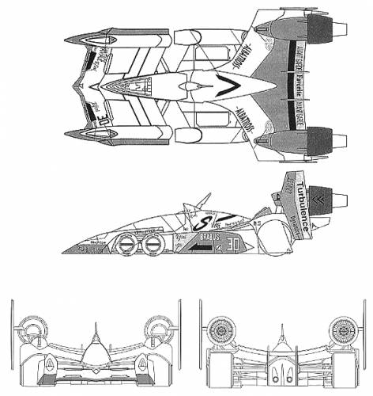
What Is an Class/Object
Class(blueprint )
Object(instance)

Slide 4


What Is an Class/Object
Class(blueprint )
Object(instance)

Slide 5



What Is an Class/Object
Class(blueprint )
Object(instance)
behavior?
state?

Slide 6
Class/Object
Declaring Classes
class ClassName{
//states
// behaviors
}
Creating Objects/Instances
new ClassName()
ClassName cn = new ClassName();
type varName = real value;

Slide 7
Declaring Classes
modifiers class ClassName{
//fields - state
//methods - behavior
}
Access Modifiers
public, private...
class name
public class MyClass{
//start of fields
int a = 0;
String b = "";
Other o = new Other();
//methods
void toString(){ return ""}
}

Slide 8
Declaring Fields
public class Clothes {
public String color; //red, blue and yellow
private char size; //S, M, L...
}
Live demo with eclipse
Create at least three classes.
"Hello world" example, Empty class, Clothes class.
Access Modifiers.
Change the value of fields.

Slide 9
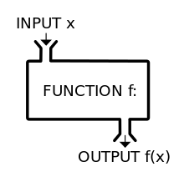
Defining Methods/Function
Function
f(x) = x + 1
f(1) = ?
g(x, y) = x*y
g(3, 4)
k(x, y, z) = x – y + z
k(1, 2, 3) = ?

Slide 10
Defining Methods/Function
Function
g(x, y) = x * y
g -> Function/method name
x, y -> Parameter list
= -> The value that method yields
x * y -> The method body

Slide 11
Defining Methods/Function
public class Calculator{
public double add (double a, double b){
return a + b;
}
}
modifiers
return type
name
(parameter list)
{method body}
g(x, y) = x * y

Slide 12
Calling method with object
public class Calculator{
public double add(double a, double b){return a + b;}
}
Calculator c = new Calculator();
double d1 = c.add( 1.0, 2.0);
double d2 = new Calculator().add( 1.0, 2.0);

Slide 13
Methods Return Type
public class Calculator{
public double add (double a, double b){
return a + b;
}
}
type varName = real value;
___________ sum = new Calculator().add(1.0,2.0)
Return Type:
*Primitive type
*Object
*void

Slide 14
Defining Methods/Function
public class Clothes {
String color;
public String getColor (){
return color;
}
}
Live demo with eclipse(change the state of color)

Slide 15
Defining Methods/Function
public class Clothes {
String color;
public void changeColor (String thatColor){
color = thatColor;
}
}
Live demo example

Slide 16
Defining Methods/Function
public class Clothes {
String color;
public void setColor (String color){
this.color = color;
}
}

Slide 17
Defining Methods/Function
public class Clothes {
private String color = "red"; //Color only.
public String getColor (){ return color;}
private Boolean isColor(String clr){
return "red".equals(clr) || "blue".equals(clr) || "green".equals(clr)
}
public void setColor (String clr){
if(isColor(clr)){ this.color = clr; }
}
}
Encapsulation!

